Slide 1
Deep Optimisation Multi-Scale Evolution by Inducing and Searching in Deep Representations
Jamie Caldwell j.r.caldwell@soton.ac.uk*
Joshua Knowles joshua.knowles@invenialabs.co.uk
Christoph Thies c.thies@soton.ac.uk
Filip Kubacki fk1g19@soton.ac.uk
Richard Watson r.a.watson@soton.ac.uk
University of Southampton
Agents, Interaction and Complexity Research Group
NGCM: EPSRC Centre for Doctoral Training grant EP/L015382/1.
Notes:
Talk to you about the progress of novel evolutionary optimisation algorithm being developed

Slide 2
Overview
The Deep Optimisation Algorithm.
Performance Evaluation.
Multi-dimensional Knapsack Problem (MKP).
Investigation into the distinguishing types of problem characteristics.
What multi-scale evolution provides for evolutionary search.
Notes:
DO and deep representation can solve that others cannot

Slide 3
Hill Climbing in a Search Space
Simple evolutionary process
Hill climbing in search space.
Solution gets trapped.
Reset a solution (solution restart)
Still susceptible to getting trapped
But trapped at a different local optimum
Repeatedly reset a solution
Unless we are extremely lucky, search will only find local optima. But…
The distribution of solutions can provide information about the problem structure.

Slide 4
Hill Climbing in a Search Space
Require larger changes for a hill-climber to escape a local optimum and find a fitter solution.
Hill-climbing in a different solutions space to escape local optima.
Transformation of the search space.
Transformation of a solutions neighbourhood.
We require large adaptive changes.
Large random changes are unlikely to beneficial.
Dependent on the problem structure.

Slide 5
Multi Level Representation
Induce a compressed representation of solutions found at the current level of organisation
Extract features of covariation in the dataset.
A higher level organisation/representation of original search space
Solutions far away in the original space become closer/neighbours in the reorganised space.
The new induced space can also have relative local optima.
Overcome this by learning an additional compressed representation
A deep representation of a solution space.
Notes:
Repeating the process
The higher order organisation is treated as the solution level organisation
Higher-order organisation has its own local optimal (relative local optima)
Therefore overcome this, by learning a compressed representation of the higher-order representation
Inducing an even higher-order representation
This process is repeated, constructing a deep representation of a search space.
Performing multiple transitions

Slide 6
Multi Level Search
Hill-climb at the original solution representation
Solutions encode to the compressed representations
Hill-climb in the compressed space is decoded back to the original solution space.
Makes large but coordinated changes at the original solution representation
The compressed representation, can also get trapped, so search at an even higher-level representation
Multi-level of larger changes:
Searching in Deep representations
Large adaptive changes at the original solution space = small changes in a compressed representation.

Slide 7
Multi Level Search
Hill-climb at the original solution representation
Solutions encode to the compressed representations
Hill-climb in the compressed space is decoded back to the original solution space.
Makes large but coordinated changes at the original solution representation
The compressed representation, can also get trapped, so search at an even higher-level representation
Encode to a deep representation
Hill-climb in the deep representation
Decodes back to the lower-level representations
Large change in the lower-level representation
Even larger change at the original solution representation.
Notes:
Add shadows between large changes.

Slide 8
Evolutionary Transitions in Individuality
The theory of Major Transitions in Individuality explains evolvability through a multi-scale process.
Unicellular life transitioned into multicellular organisms
Multiple individuals at one level of organisation form associations that result in a new evolutionary unit at a higher level of organisation
Individuality, and therefore variation and selection, is continually revised.
How to induce a multi-level representation of a search space?
Links with deep learning principles: Extracting and representing multi-level features from a distribution of data.
Notes:
ETI provides a mechanisms which we can draw inspiration from:

Slide 9
Deep Optimisation
Deep Optimisation (DO) uses an autoencoder model to emulate the process of successive transitions in individuality.
Enabling multi-scale optimization.
1) Inducing a compressed representation of a solution space.
Local search discovers combinations of units that contribute to the fitness of a solution.
Use autoencoder model to induce a compressed representation of a solution
Model extracts and represents features of the dataset at the hidden layer.
Optimisation is separated from learning.

Slide 10
Deep Optimisation
2) Search rescaled to compressed representation (Transition)
Use encoder network to transform a solution to a higher-order space
Local search at compressed representation
Use decoder network to transform back to solution representation
Model-Informed Variation.
Creates a new distribution of solutions locally optimal in the higher-order space.
How higher order units combine
3) Repeat the process of inducing a even higher-order space and then search in this space.
Add a hidden layer to the autoencoder model - layerwise learning.
Each layer performs a transition
Constructs a deep representation

Slide 11
The Deep Optimisation Algorithm
Class of algorithms that use machine learning methods to replace evolutionary operators.
State of the art methods (hBOA and LTGA) do not use state-of-the-art machine learning methods.
Deep Optimisation:
Explicitly transforms the representation that evolutionary search operates at
Transforming the neighbourhood of a solution
Capable of constructing a deep representation
Notes:
DO in the class of MOBAs
uses variation and selection
The novel aspect of DO is the transition process, and in turn the deep construction (layerwise process).
Eg, hBOA, and LTGA

Slide 12
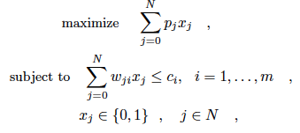
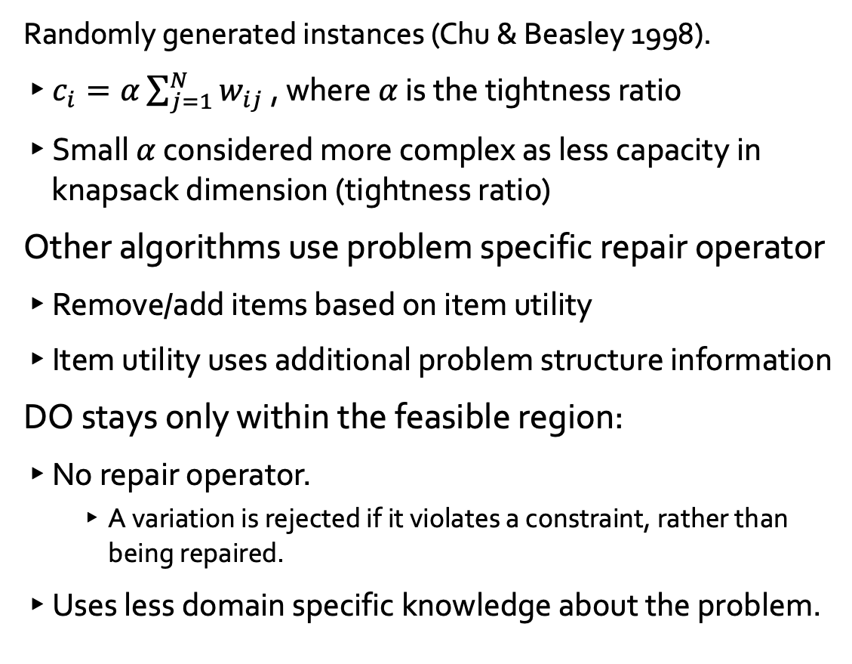
Performance Evaluation using MKP
Randomly generated instances (Chu & Beasley 1998).
$c_{i}=α\sum_{j=1}^{N}{w_{ij}}$ , where $α$ is the tightness ratio
Small $α$ considered more complex as less capacity in knapsack dimension (tightness ratio)
Other algorithms use problem specific repair operator
Remove/add items based on item utility
Item utility uses additional problem structure information
DO stays only within the feasible region:
No repair operator.
A variation is rejected if it violates a constraint, rather than being repaired.
Uses less domain specific knowledge about the problem.

Slide 13
DO outperforms MBOAs on MKP
DO outperforms other leading MBOAs.
Deep representation (DO) outperforms a shallow representation (DO1).
DO1 - Autoencoder limited to a single hidden layer.
Notes:
The results show DO is able to exploit more structure from the population that other MBOAs cannot.
Coulmn chart rather than a table
- 2 graphs alpha 0.25 and alpha 0.75

Slide 14
But Why?
DO capable of exploiting more problem structure.
Even when alternative methods use extra domain knowledge (repair).
Results indicate that this structure is deep.
We want to understand what is the nature of ’more problem structure’.
Randomly generated MKP instances = unclear problem structure.
What are the problem structure characteristics that:
DO is exploiting that other methods cannot?
A deep representation is exploiting that a shallow representation cannot?

Slide 15
Differences between the methods
All Algorithms are reaching for the same goal:
Using the model to compress the search space – induce a higher-order representation.
The search within the compressed space to find fitter solutions – search at the level of the higher-order organisation.
Differences between the capacity of a model:
hBOA uses a Bayesian network.
LTGA limited to a tree representation (hierarchical agglomerative clustering).
DO uses a deep feed-forward neural network.
Notes:
MBOA comparison – Model-informed search
All methods are reaching for the same goal. Using the model to compress the search space, and then using this space to find fitter solutions.
MIV does that explicitly and operate a multiple scales of compression (representation)

Slide 16
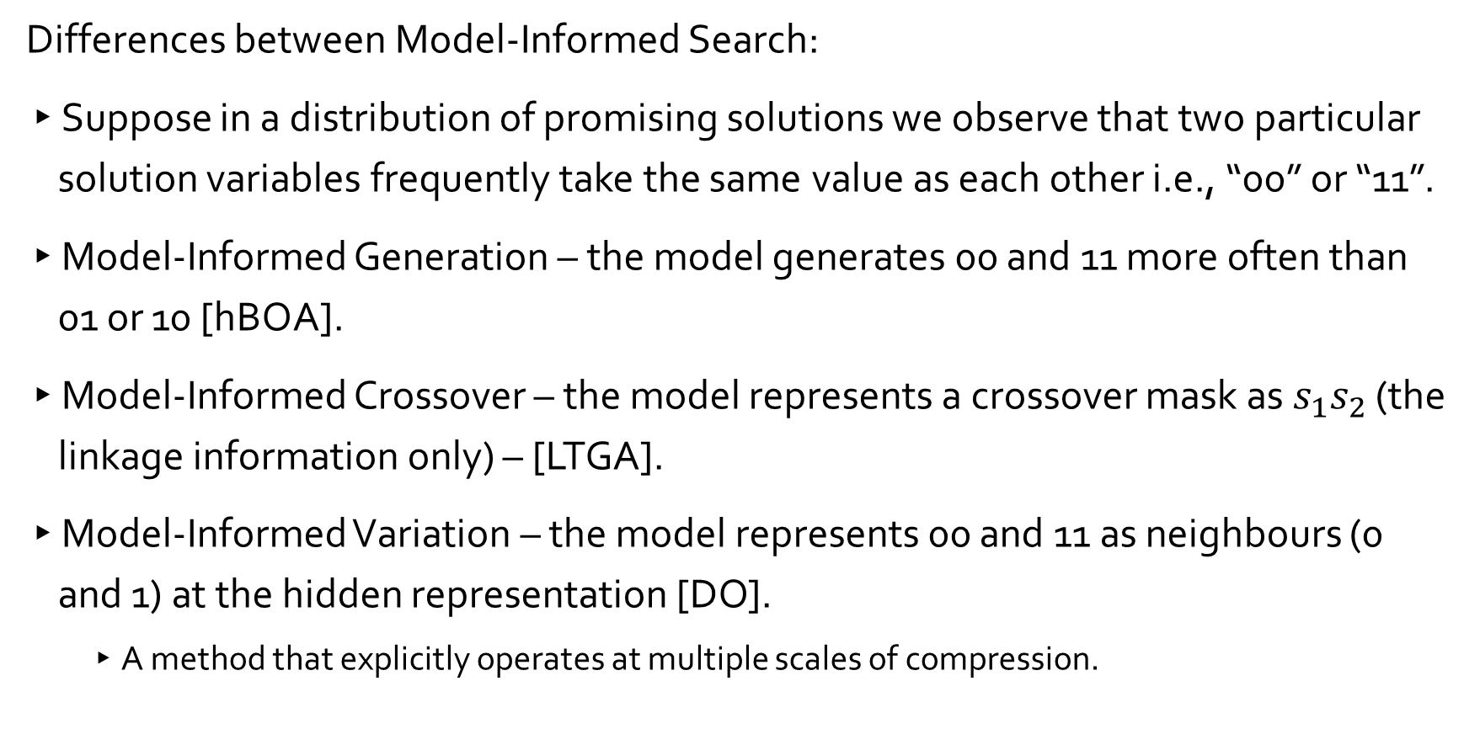
Differences between the methods
Differences between Model-Informed Search:
Suppose in a distribution of promising solutions we observe that two particular solution variables frequently take the same value as each other i.e., “00” or “11”.
Model-Informed Generation – the model generates 00 and 11 more often than 01 or 10 [hBOA].
Model-Informed Crossover – the model represents a crossover mask as $s_{1}s_{2}$ (the linkage information only) – [LTGA].
Model-Informed Variation – the model represents 00 and 11 as neighbours (0 and 1) at the hidden representation [DO].
A method that explicitly operates at multiple scales of compression.
Notes:
MBOA comparison – Model-informed search
All methods are reaching for the same goal. Using the model to compress the search space, and then using this space to find fitter solutions.
MIV does that explicitly and operate a multiple scales of compression (representation)

Slide 17
Synthetic Optimisation Problem
We investigate this by constructing a problem that allows for separation of:
The way structure needs to be represented
Investigate model capacity.
The way structure is used.
Investigate model-informed search.
We explore:
3 different characteristics of structure representation.
non-overlapping, overlapping and non-pairwise relationships between solution variables.
3 different characteristics of using the structure.
Generating combinations, hierarchically generating combinations and rescaling search.
Total of 9 combinations.
Here we show our findings thus far.
Notes:
Don’t yet fully understand what DO is capable of, but here we show our current findings
Show that their does exist structure that requires a deep model
Provides some insight to the types of problem characteristics that distinguishes DO from the other algorithms
Still feels complicated never the less, but we have made progress, and able to attribute particular characteristics of an algorithm, be that the model capacity or the model-informed search method, to relative optimisation capabilities and limitations – can vs cannot do.
First case of hBOA outperforming LTGA (as far as we are aware).

Slide 18
DO scales polynomially in all cases
LTGA fails as the size of overlap increases, hBOA and DO succeed.
Distinguishing the induction limitation of LTGA.
LTGA and hBOA fail to explore local neighbourhood at the organisation level of BBs, DO succeeds.
Distinguishing MIV exploitation capability
hBOA and LTGA fail with non-pairwise relationships. DO succeeds
Distinguishing the induction capability of DO
DO₁ fails to learn overlap and non-pairwise relationships.
Distinguishing deep representations from a shallow representations.
Notes:
First case of hBOA outperforming LTGA (as far as we are aware).
Show that their does exist structure that requires a deep model
Provides some insight to the types of problem characteristics that distinguishes DO from the other algorithms
Still feels complicated never the less, but we have made progress, and able to attribute particular characteristics of an algorithm, be that the model capacity or the model-informed search method, to relative optimisation capabilities and limitations – can vs cannot do.

Slide 19
Conclusion
DO showed an impressive performance on MKP instances
DO didn’t use a problem-specific repair operator.
Distinct problem characteristics that DO can solve that neither hBOA nor LTGA can solve.
There exists problem structure that distinguishes the performance of DO.
Attribute particular problem characteristics to induction or model-informed search differences
A Deep representation is necessary to capture the problem structure.
There exists problem structure that distinguishes the performance of a deep representation
Further understanding required:
Other problem characteristics
Abundance in applied problems – reasons for differences in MKP?
Rescaling limited optimisation capabilities to higher-orders of organisation enhance these methods.
Depth limited DO (DO1), LTGA and hBOA limited – by model capacity and/or model-informed search.
Demonstrating the intuitive links between ETI and deep learning for evolutionary algorithm
Strong motivation for further investigation of deep learning methods in evolutionary search.
Notes:
Show that their does exist structure that requires a deep model
Provides some insight to the types of problem characteristics that distinguishes DO from the other algorithms
Still feels complicated never the less, but we have made progress, and able to attribute particular characteristics of an algorithm, be that the model capacity or the model-informed search method, to relative optimisation capabilities and limitations – can vs cannot do.

Slide 20
Thank you for listening
Deep Optimisation: Multi-Scale Evolution by Inducing and Searching in Deep Representations
Jamie Caldwell: j.r.caldwell@soton.ac.uk*
Joshua Knowles: joshua.knowles@invenialabs.co.uk
Christoph Thies: c.thies@soton.ac.uk
Filip Kubacki: fk1g19@soton.ac.uk
Richard Watson: r.a.watson@soton.ac.uk

